Slide 1
Getting started with Databricks
Data science tools basics

Slide 2
Contents
What & Why
File System Utilities
Spark DataFrame, Delta Lake, SQL Context
Databricks Data Visualization Tools
R Data Science Tools
Python Data Science Tools

Slide 3
What & Why Databricks?
1. What & Why
What:
Easy-to-use big data analysis tool connecting to Apache Spark
Spark is typically built on top of Hadoop distributed file system (hdfs)
hdfs keeps multiple copies of partitioned data across nodes and allows for parallel processing via MapReduce
Spark allows for fast parallel processing on hdfs via RDD (hence often “big data analysis” = Spark)
RDD allows for in-memory computing with optional caching. Shared variables can be used across worker nodes.
Spark is written in Scala, which is a modern version of Java.
Runs on AWS, Azure, or GCP
Storage and connections
Compute cluster’s memory gets cleaned up each time it shuts down
databricks file system (dbfs) = a persistent store automatically connected to the cluster
One can mount hive metastores that house hdfs, Delta Lake, and connect via ODBC/JDBC
FAQ: https://databricks.com/product/faq
Why:
Scalable in compute resource
Mixing SQL, python, and R for data wrangling, analysis, and visualization
Performing streaming data or big data engineering tasks in Delta Lake
Scheduling tasks/jobs/alerts for recurring data processing
Affordable and pay-as-you-go (don’t forgot to shut down when it’s done)

Slide 4
What’s in it for me?
1. What & Why
Data Analysts
Analyze “big data” that does not fit in local-device memory
Automate/schedule recurring data-related tasks
Develop integrated dashboards
Data Engineers
Master complex data ETL, including unified streaming and batch processing
Leverage Delta Lake for scalability, data governance, and regulatory compliance
Data Scientists
Develop machine-learning models with “big data”
Combine best analytic tools across platforms -- Spark API, python, R, and Scala
Resources
Databricks academy: https://databricks.com/learn/training/home
https://databricks.com/resources?_sft_resource_type=product-videos
https://docs-dx.comcast.com/kb/cloud-compute/cloud-compute-user-guide
LinkedIn Learning via Workday:
Spark for Machine Learning & AI
Azure Spark Databricks Essential Training
Introduction to Spark SQL and DataFrames
Apache Spark Essential Training: Big Data Engineering
Apache Spark Deep Learning Essential Training
Big Data in the Age of AI
Architecting Big Data Applications: Real-Time Application Engineering

Slide 5
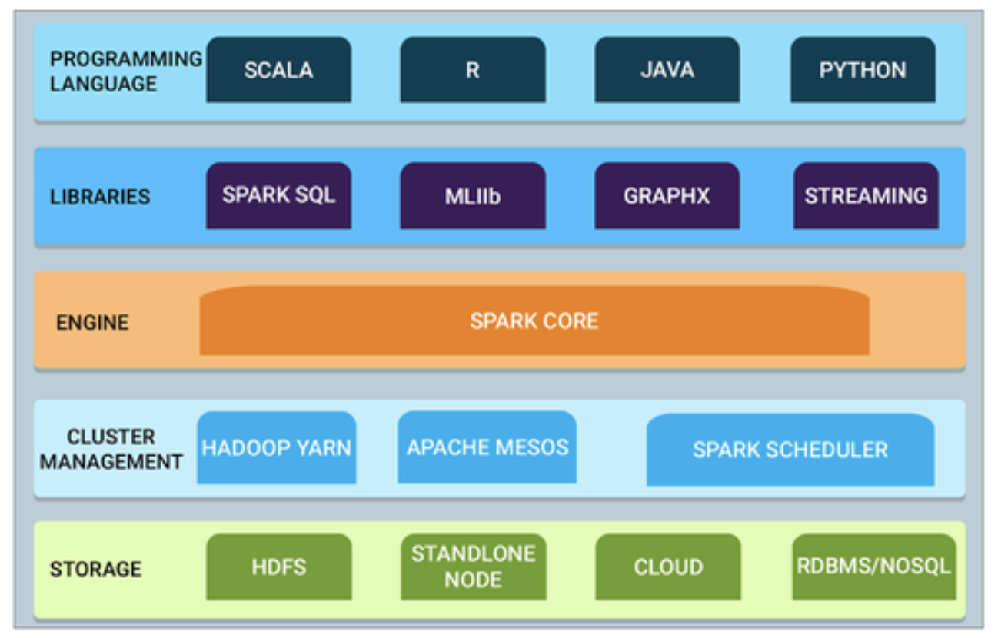
Big Data Analysis Simplified
1. What & Why
Engineering...
My interpretation as end user
Spark session
Python session
R
session
SQL Context

Slide 6
When to use?
1. What & Why
*Use cases may vary depending on work environments, resources, and nature of tasks.
Databricks
Big data processing or ad hoc analysis
Complex data wrangling and data visualization
New business insight projects
Experiment with day-to-day tasks to find out more about when to use for yourself
SQL query fabric - Presto/Trino
BAU SQL proc dev. and maintenance
BAU ad hoc SQL analyses
https://docs-dx.comcast.com/kb/query-fabric/query-fabric-user-guide/
Python Jupyter/PyCharm
Laptop-RAM-size data analysis + ML
RStudio
Laptop-RAM-size data analysis + ML
* Also possible to connect to Databrikcs clusters from PyCharm, Jupyter, RStudio

Slide 7
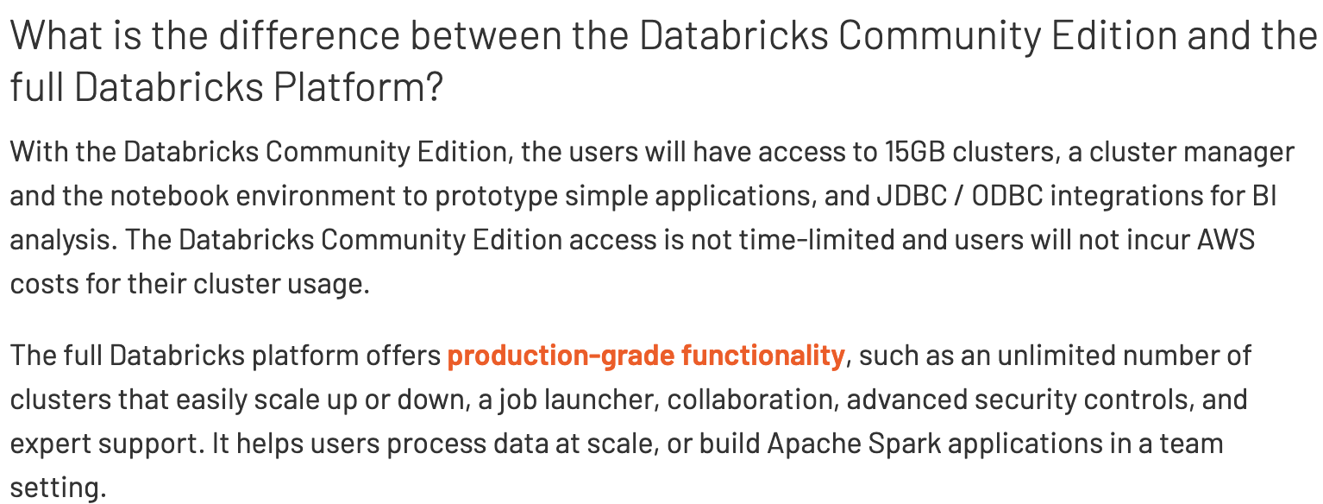
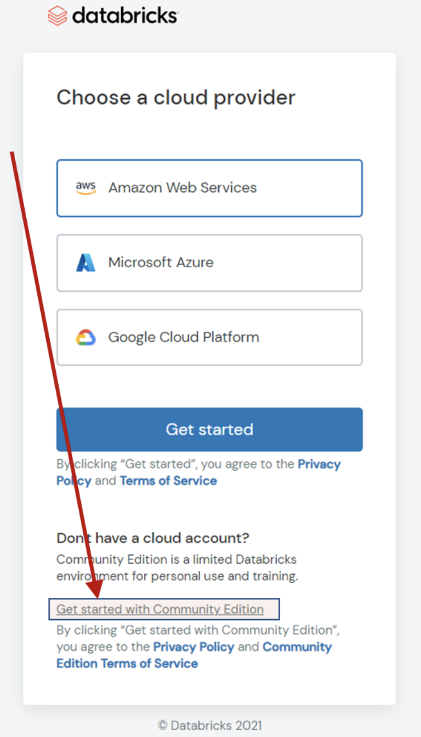
Free-Trial or Community Edition
1. What & Why
One can start with free of charge via a standard 14-day free trial or Community Edition:
Free-Trial : https://docs.databricks.com/getting-started/try-databricks.html
You need to connect to an AWS/Azure/GCP account.
The default cluster-setup runs faster than the community edition’s cluster.
After-trial: about $0.40/DBU. 1 DBU = 1 hr of standardized compute resource
Community Edition: https://databricks.com/product/faq/community-edition
You need to create a cluster each time.
It comes with similar capabilities as in Free-trial.
Hard to find!

Slide 8
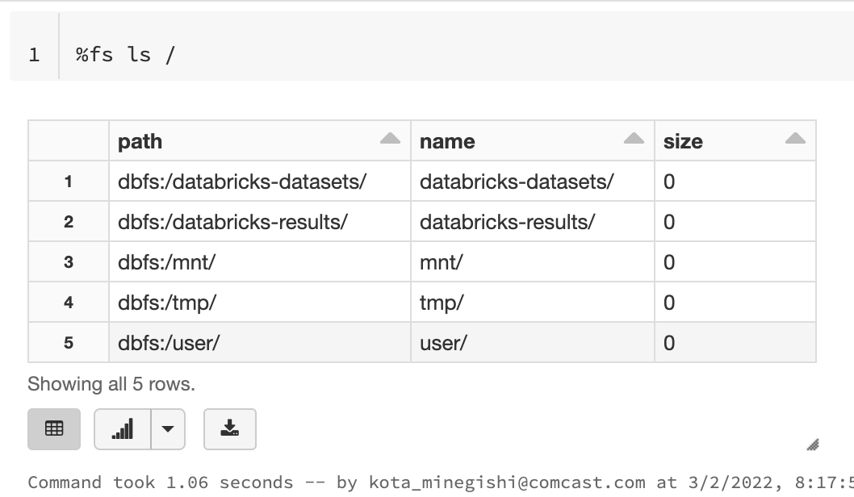
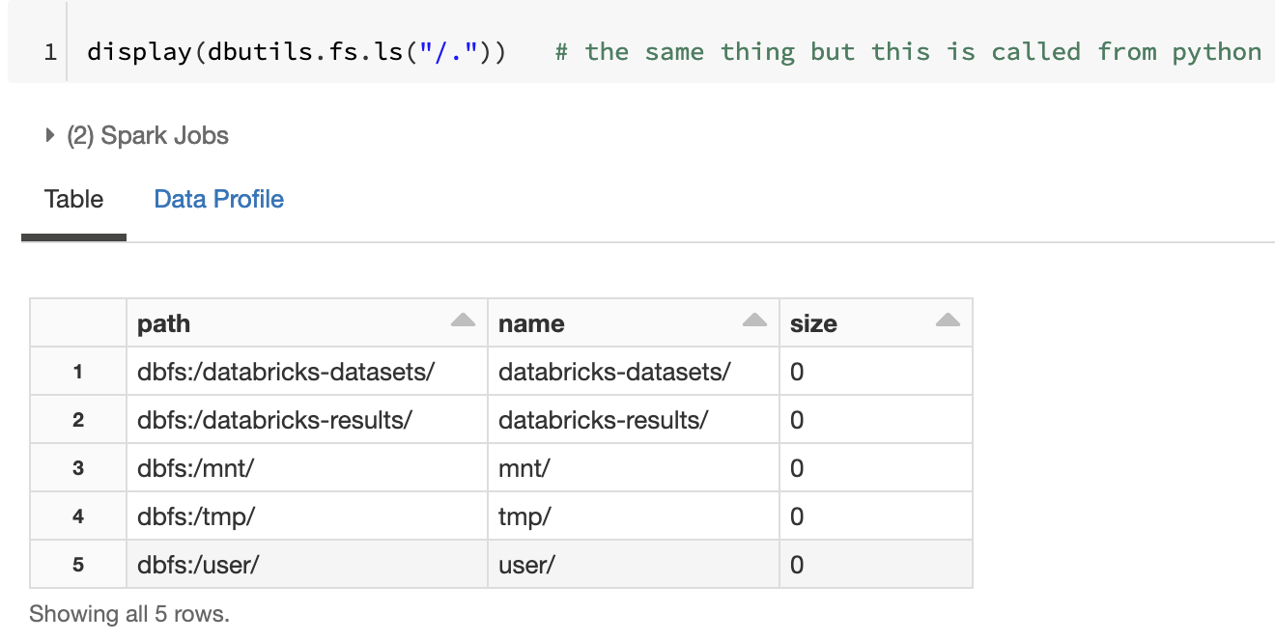
File system utilities
2. File system utilities
%fs ls / or ls /dbfs or dbutils.fs.ls(’/’) shows the root of dbfs
dbutils.fs comes with:
Usual file system methods: ls, cp, head, mkdir, mv, put, rm
Mount methods: mount, unmount, mounts, refreshMounts

Slide 9
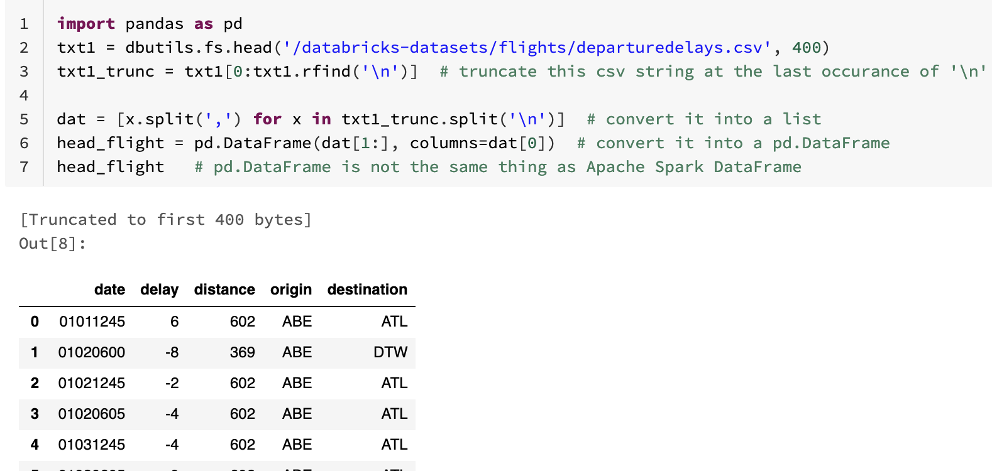
2. File system utilities
Reading file paths in python allows for a quick inspection of data file
Example: read the first 400 characters in flights csv data and put it into a pandas DataFrame

Slide 10
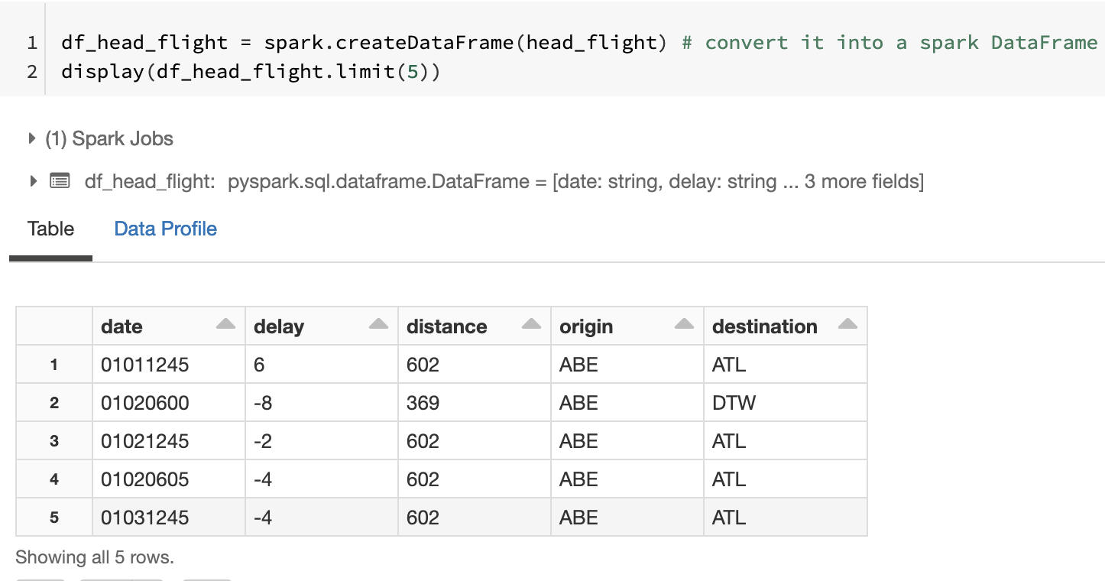
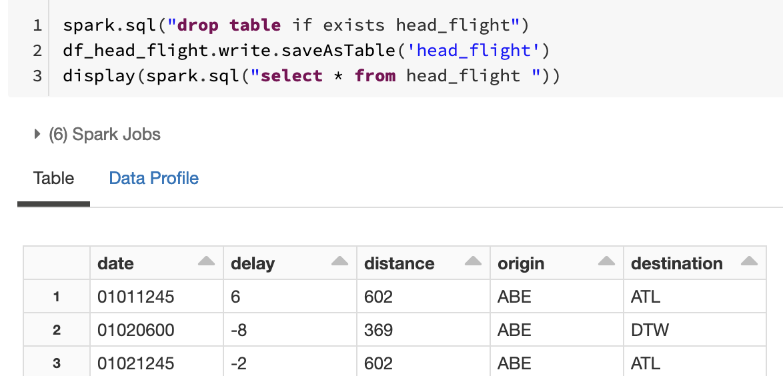
Spark DataFrames
3. Spark DataFrame, Delta Lake, SQL Context
Apache Spark DataFrame is the main table-like data concept
Not exactly the same as pandas DataFrame but similar
Has lots of panda-like data wrangling methods
select, groupBy, agg, orderBy, where, columns, crosstab, dropna, head, join, write, etc.
Can be put in hive metastore and be queried by spark.sql
https://spark.apache.org/docs/latest/sql-programming-guide.html

Slide 11
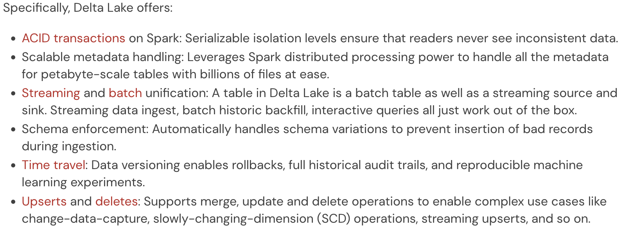
Delta Lake
3. Spark DataFrame, Delta Lake, SQL Context
What is Delta Lake? (3 min video)
https://docs.databricks.com/delta/index.html

Slide 12
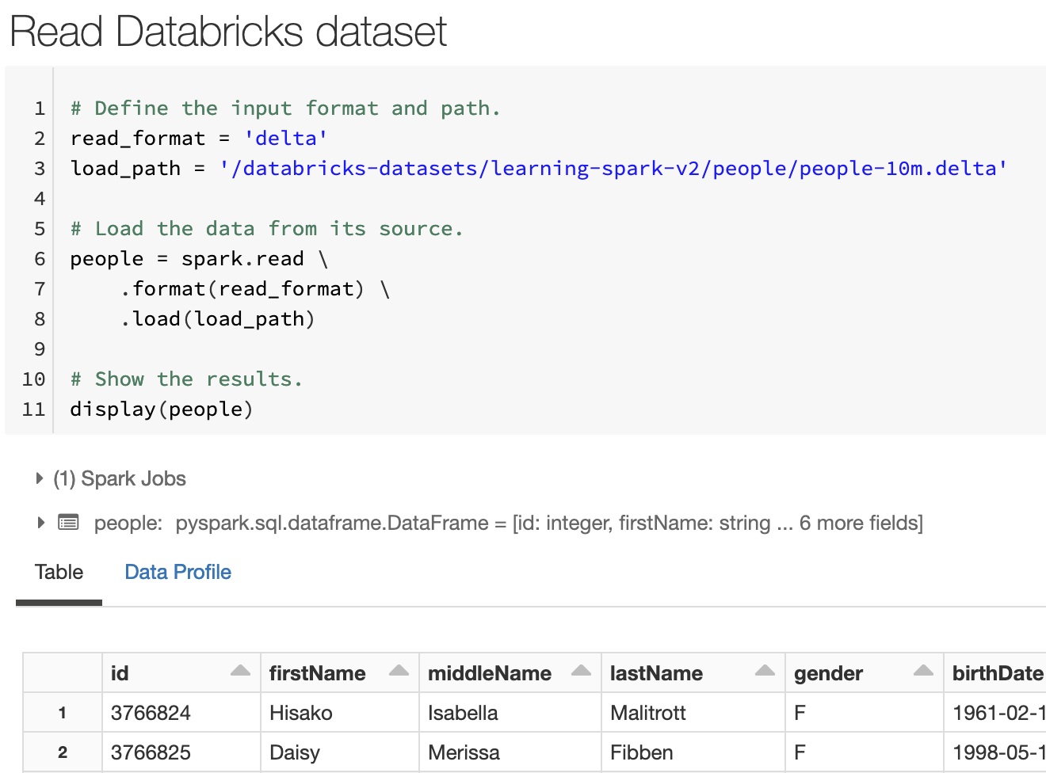
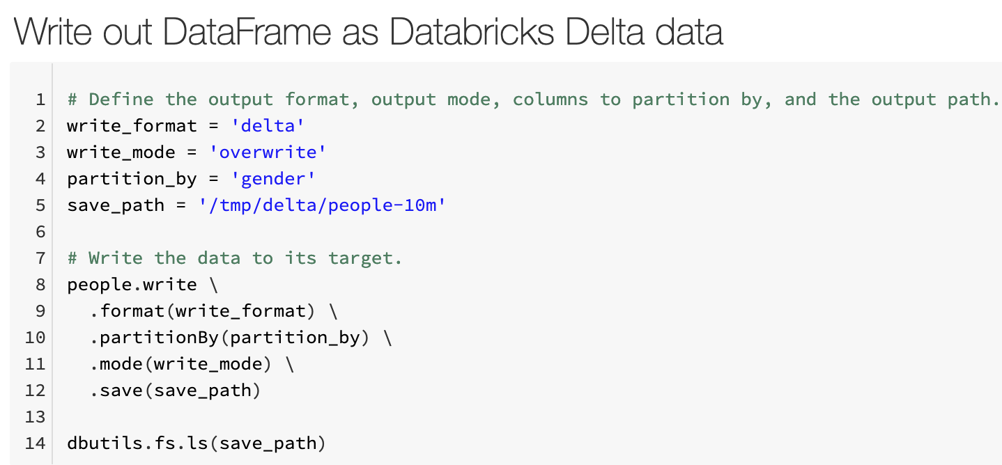
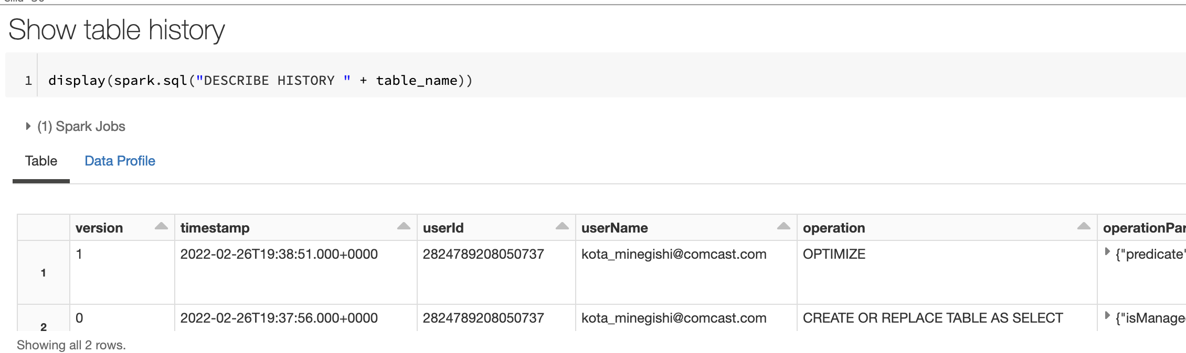
3. Spark DataFrame, Delta Lake, SQL Context
“delta” format = parquet files + a delta log file.
Delta lake tables can show table history and rollback

Slide 13
Spark DataFrame to SQL Context
3. Spark DataFrame, Delta Lake, SQL Context
Unmanaged tables: Spark manages the metadata, while you control the data location.
spark.sql(“CREATE TABLE example_table USING DELTA LOCATION example_path”) creates an unmanaged table.
Data location is example_path
spark.sql(“DROP TABLE example_table”) removes its metadata from Spark but not the data.
Managed tables: Spark manages both the data and the metadata
Example_DataFrame.write.format(‘delta’).saveAsTable(‘example_table’) creates a managed table.
Data location is dbfs:/user/hive/warehouse/example_table (default= dbfs:/user/hive/warehouse)
spark.sql(“SELECT * FROM example_table”)
spark.sql(“DROP TABLE example_table”) deletes both the metadata and data.
Temporary View: Spark manages the metadata
example_table.createOrReplaceTempView(‘example_table_vw’)
spark.sql(“SELECT * FROM example_table_vw”)
https://docs.databricks.com/data/tables.html#managed-and-unmanaged-tables

Slide 14
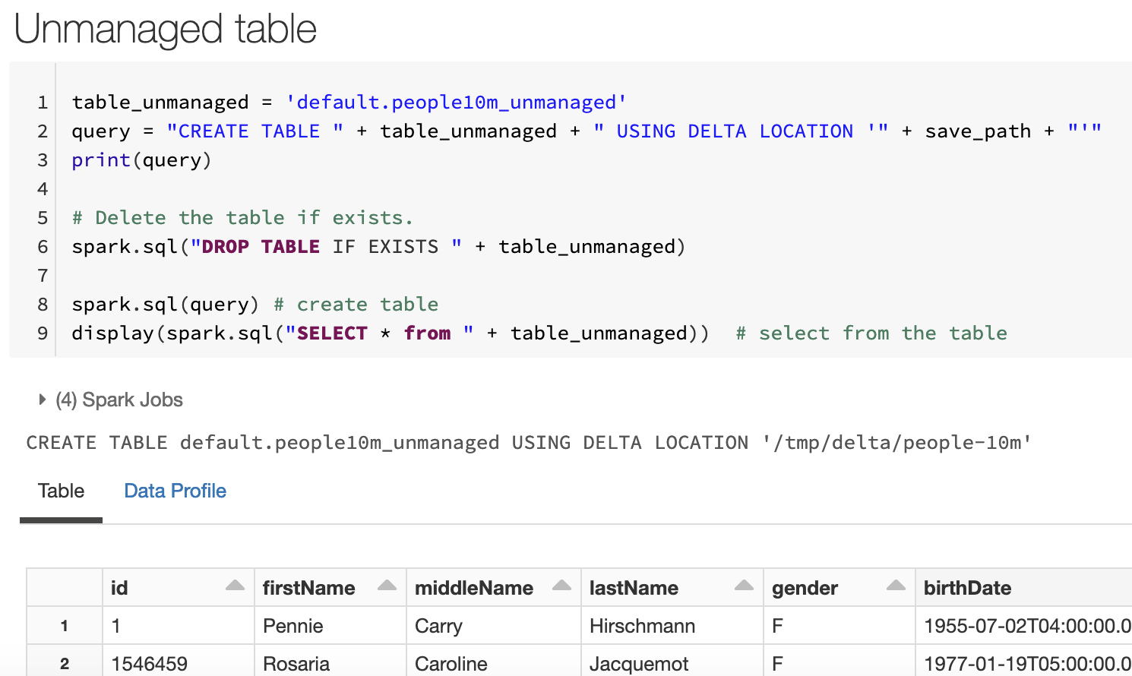
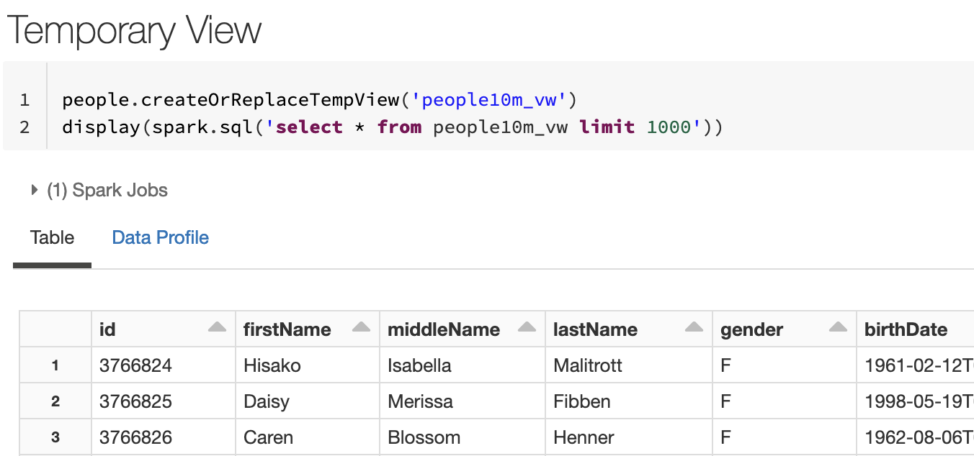
3. Spark DataFrame, Delta Lake, SQL Context
Unmanaged tables are referenced in Spark.sql via its metadata
Temporary View may operate similarly during the session

Slide 15
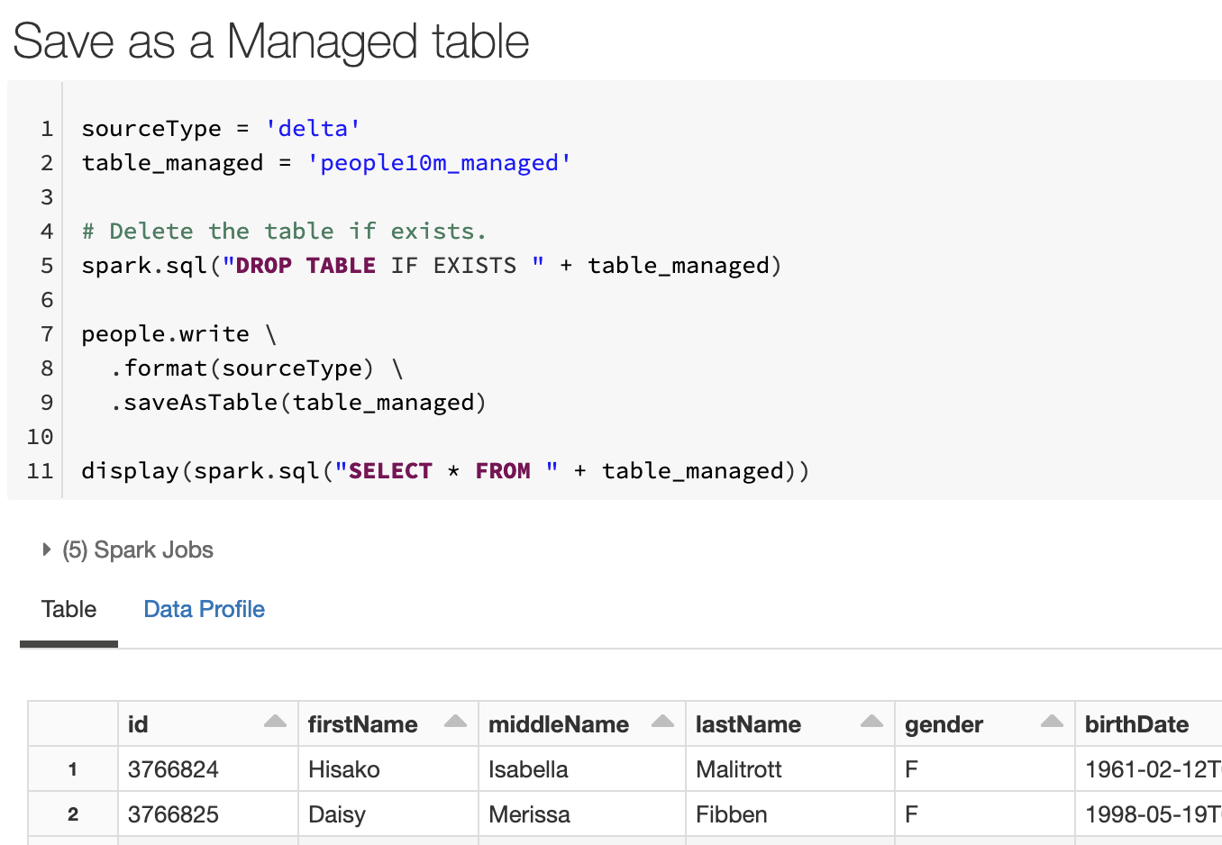
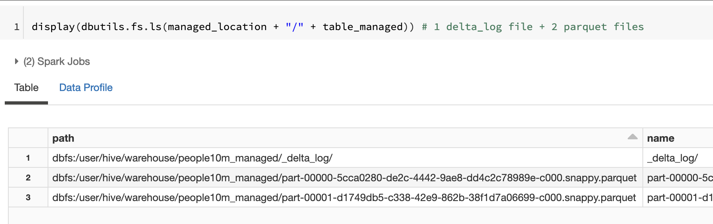
3. Spark DataFrame, Delta Lake, SQL Context
Managed tables are stored in /dbfs/user/hive/warehouse/
Delta format in this example creates 1 delta log and 2 parquet files

Slide 16
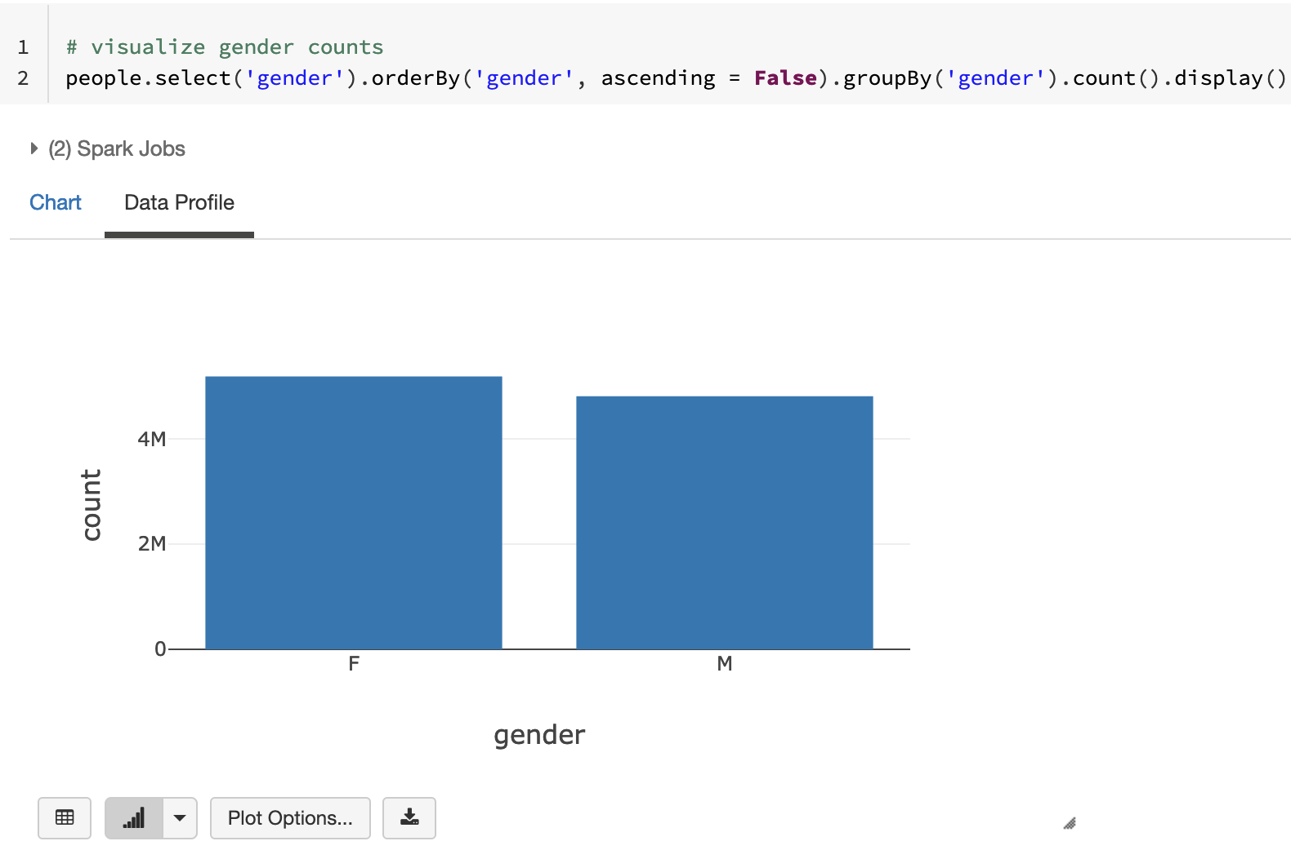
Databricks Chart Button
4. Databricks Data Visualization Tools
Simple charts can be created on the fly from a table-like output (output of python, sql, scala, or R) via GUI
Bar chart
Line chart
Scatter plot
Boxplot
Histogram
Area chart
Pie chart
https://docs.databricks.com/notebooks/visualizations/index.html

Slide 17
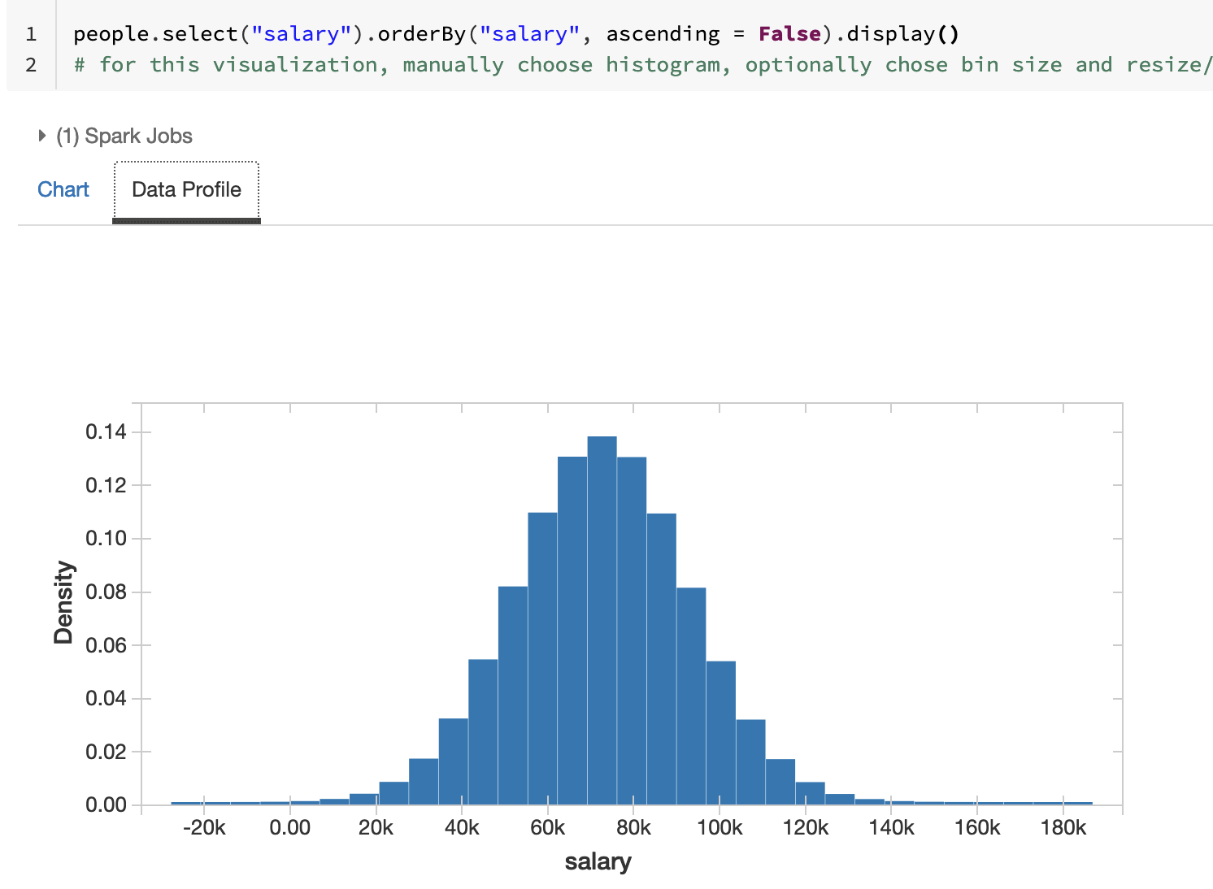
4. Databricks Data Visualization Tools
Histograms and Boxplots are useful for visualizing the distribution of a continuous variable
Bar charts and Pie charts are useful for visualizing the distribution of categorical variable
Scatter plot is useful for visualizing a join distribution of two continuous variables

Slide 18
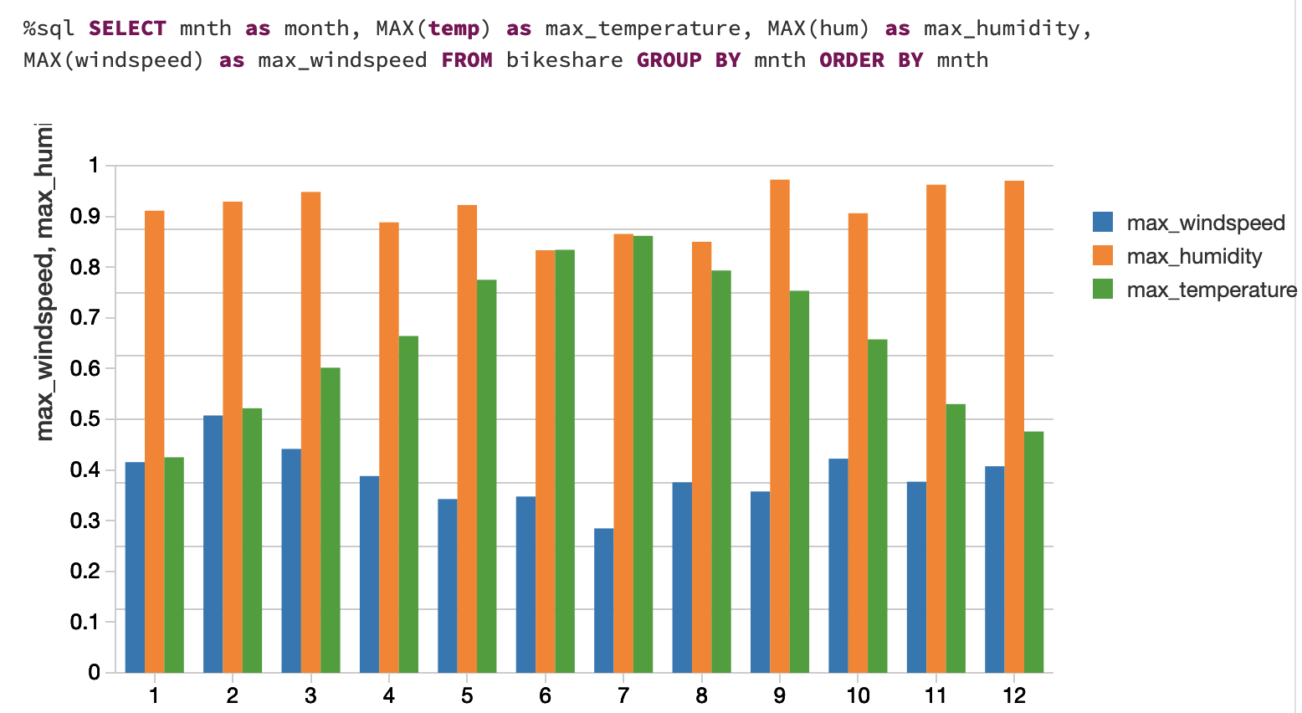
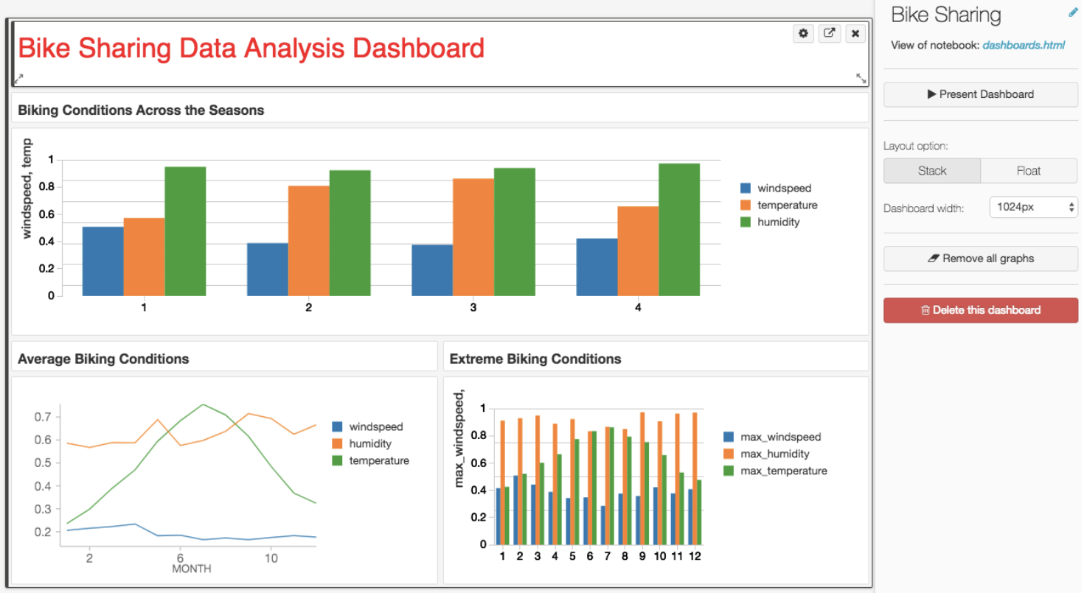
Databricks SQL, Visualization, Dashboards
4. Databricks Data Visualization Tools
Need a premium or enterprise account plan.
https://docs.databricks.com/notebooks/dashboards.html

Slide 19
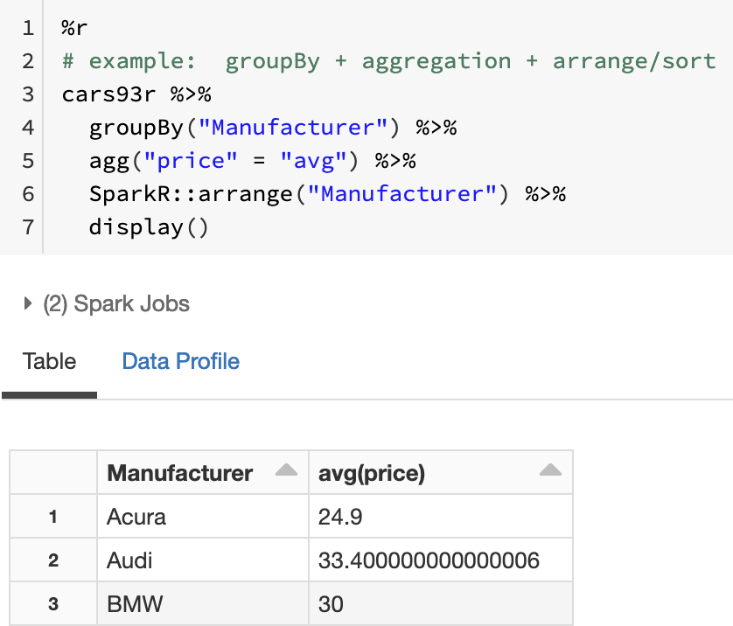
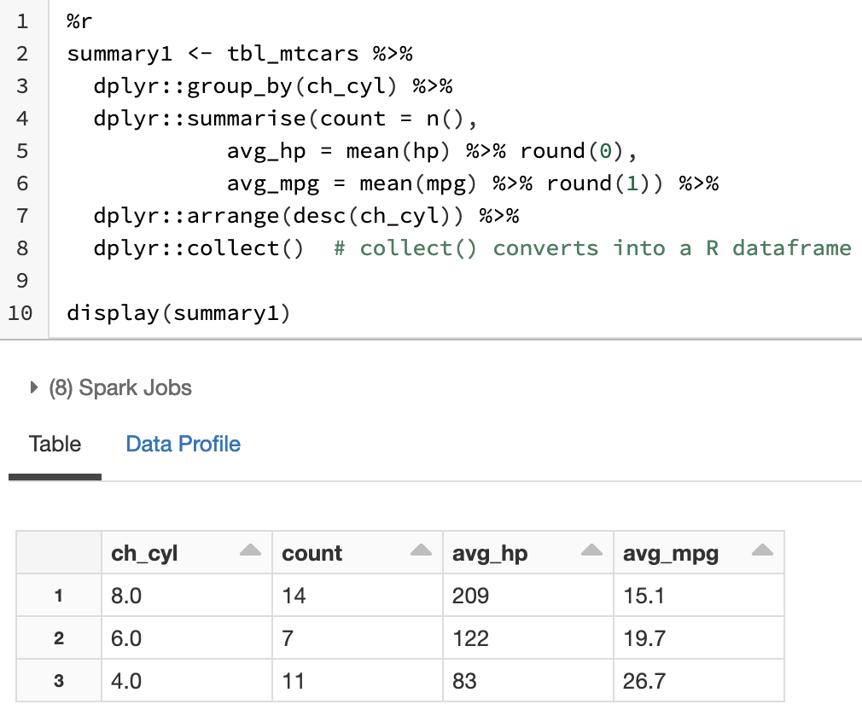
R – SparkR or sparklyr
5. R Data Science Tools
SparkR syntax is somewhat similar to pyspark
sparklyr syntax is very similar to dplyr

Slide 20
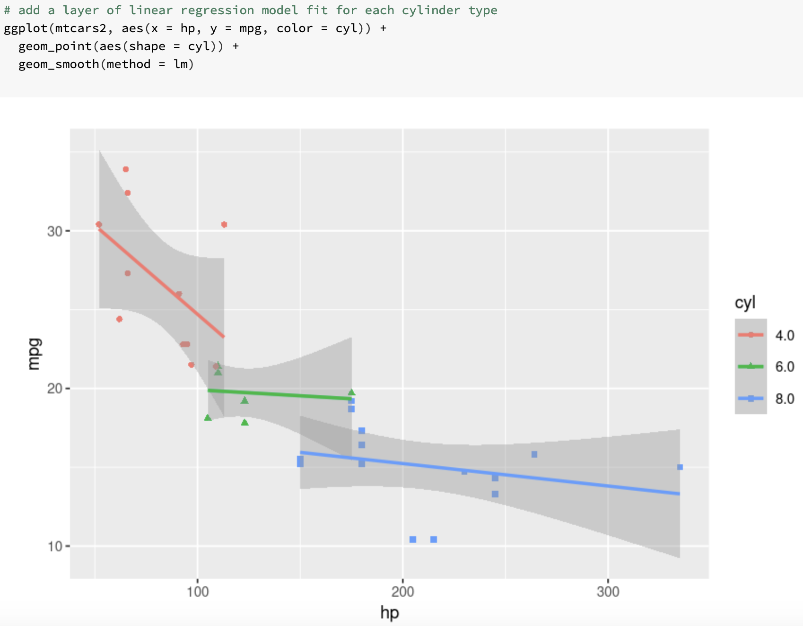
R data visualization – ggplot2
5. R Data Science Tools
Reduce spark data into R DataFrame as key statistics or a subset of data.
Then, it is easy to apply standard graphing methods in R such as ggplot2.
Syntax of ggplot2:
ggplot(dataframe, aes(...)) + geom_...
“aes” is aesthetics specifying variables for x, y, color, shape, etc.
“geom_...” provides a layer(s) of geometric objects like point, fit-curve, connected line, area, etc.

Slide 21
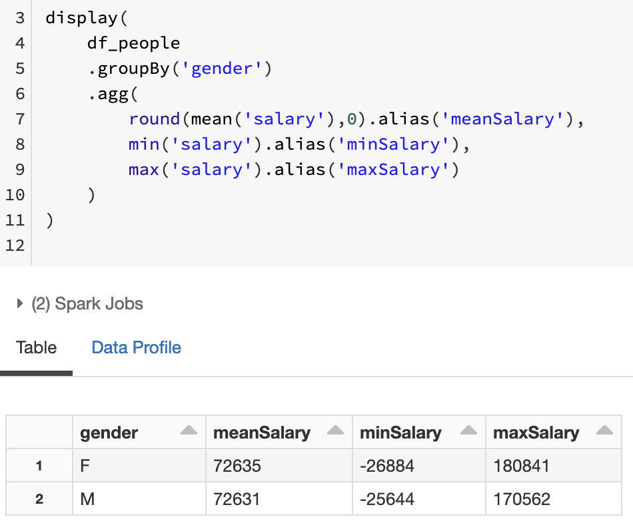
python – pyspark
6. Python Data Science Tools
pyspark syntax is somewhat similar to pandas.
“agg” function behavior is different (and maybe more intuitive) and can be used with in-place-column-rename function “alias”.
Reduce spark data into pandas dataframe as key statistics or a subset of data.
Then, it is easy to apply standard graphing methods in python such as matplotlib, seaborn, plotnine, and plotly.

Slide 22
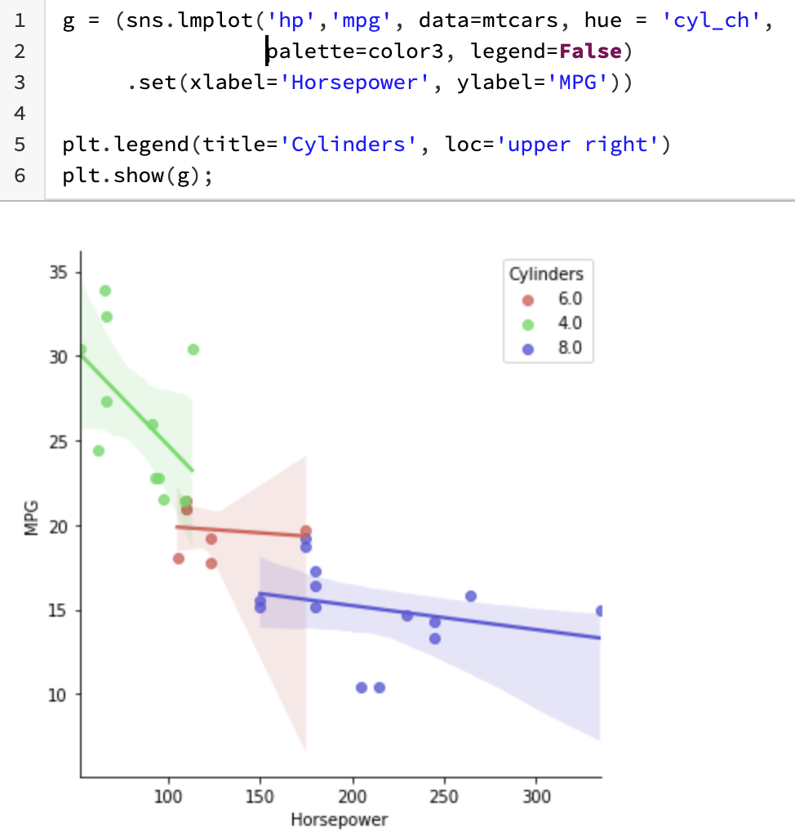
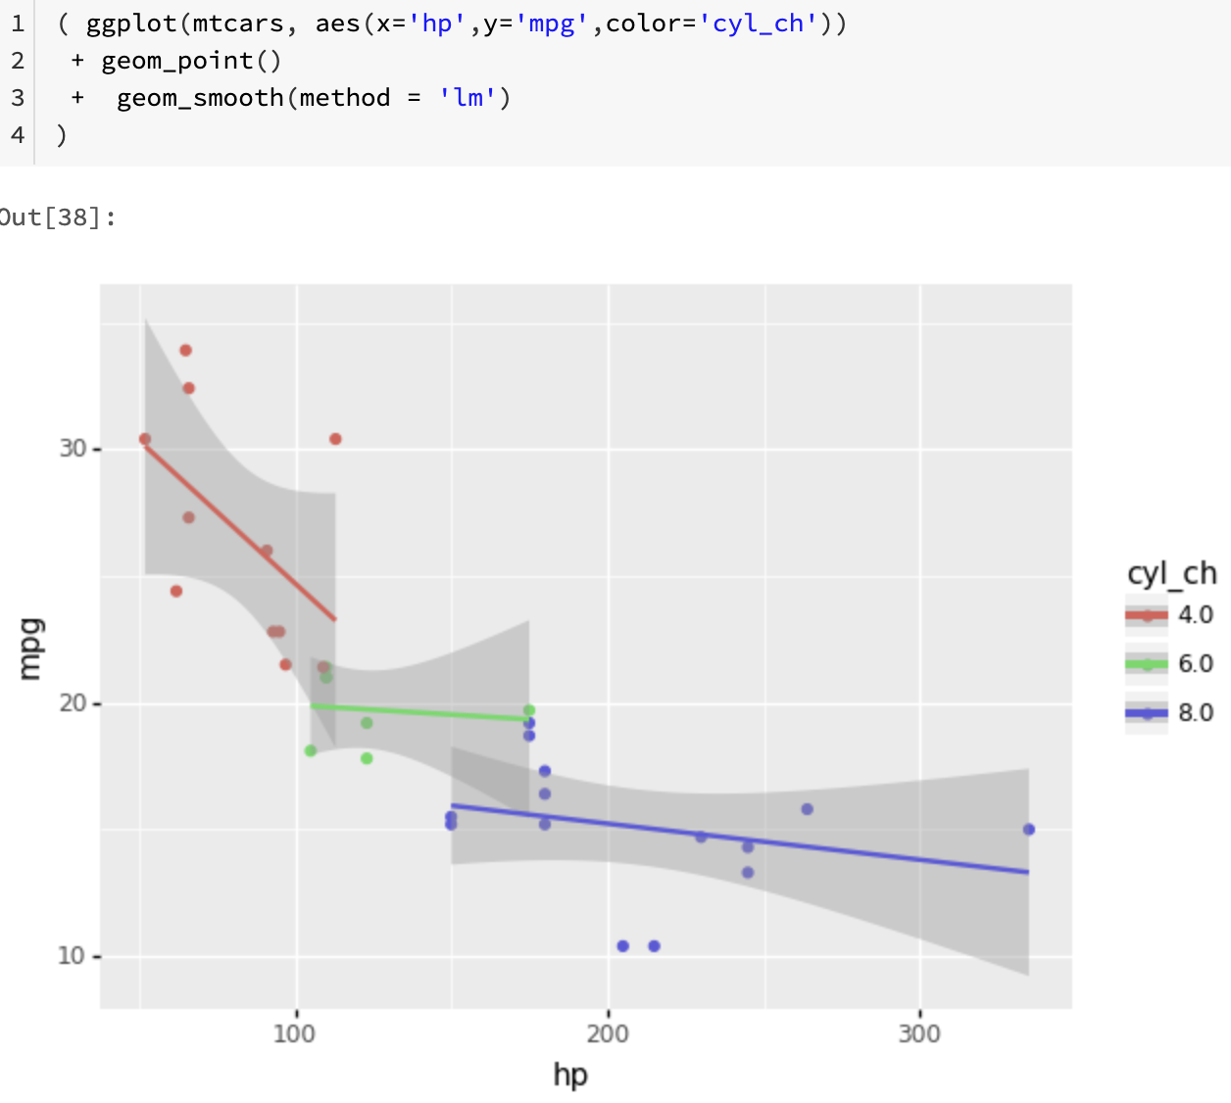
python data visualization – plotnine, seaborn, matplotlib, plotly
6. Python Data Science Tools
A subset of seaborn syntax is somewhat similar to R’s ggplot2
plotnine syntax is very similar to R’s ggplot2

Slide 23
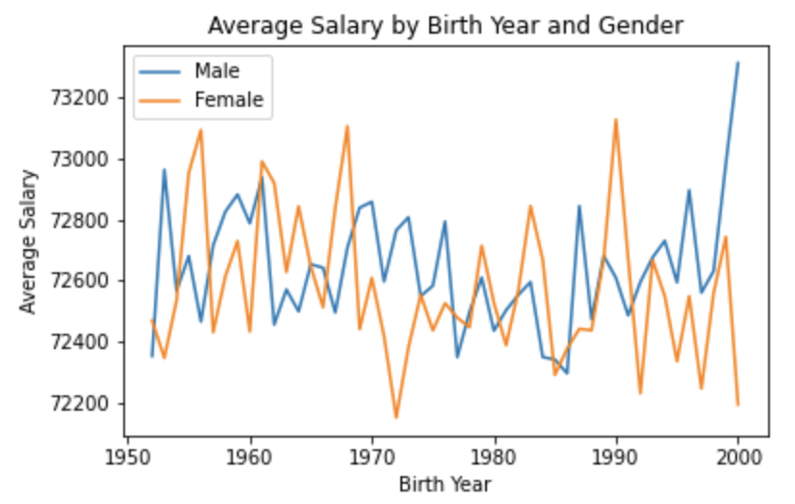
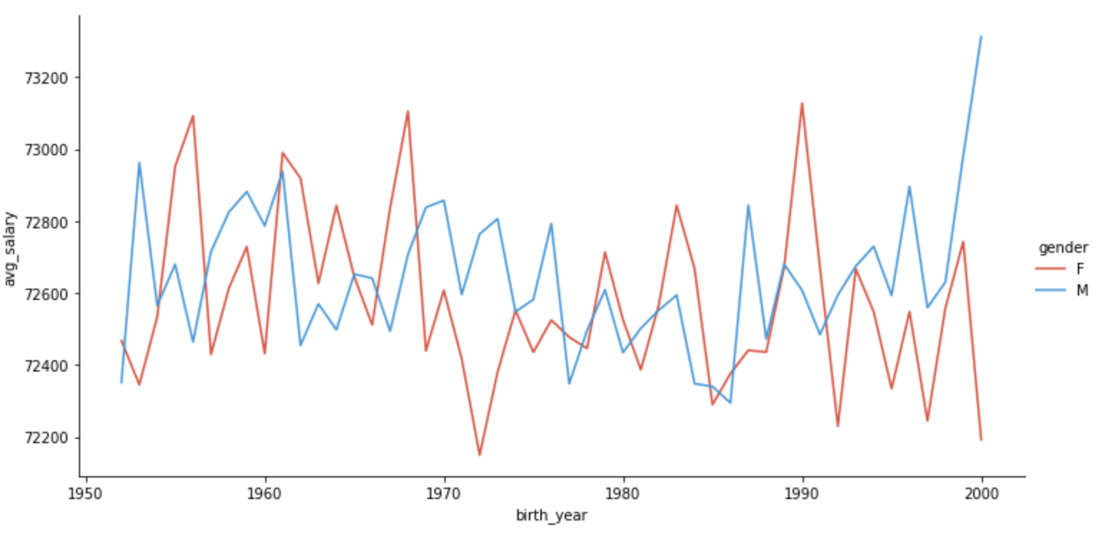
6. Python Data Science Tools
Seaborn offers a variety of graph patterns
Matplotlib is also useful for plotting something quick

Slide 24
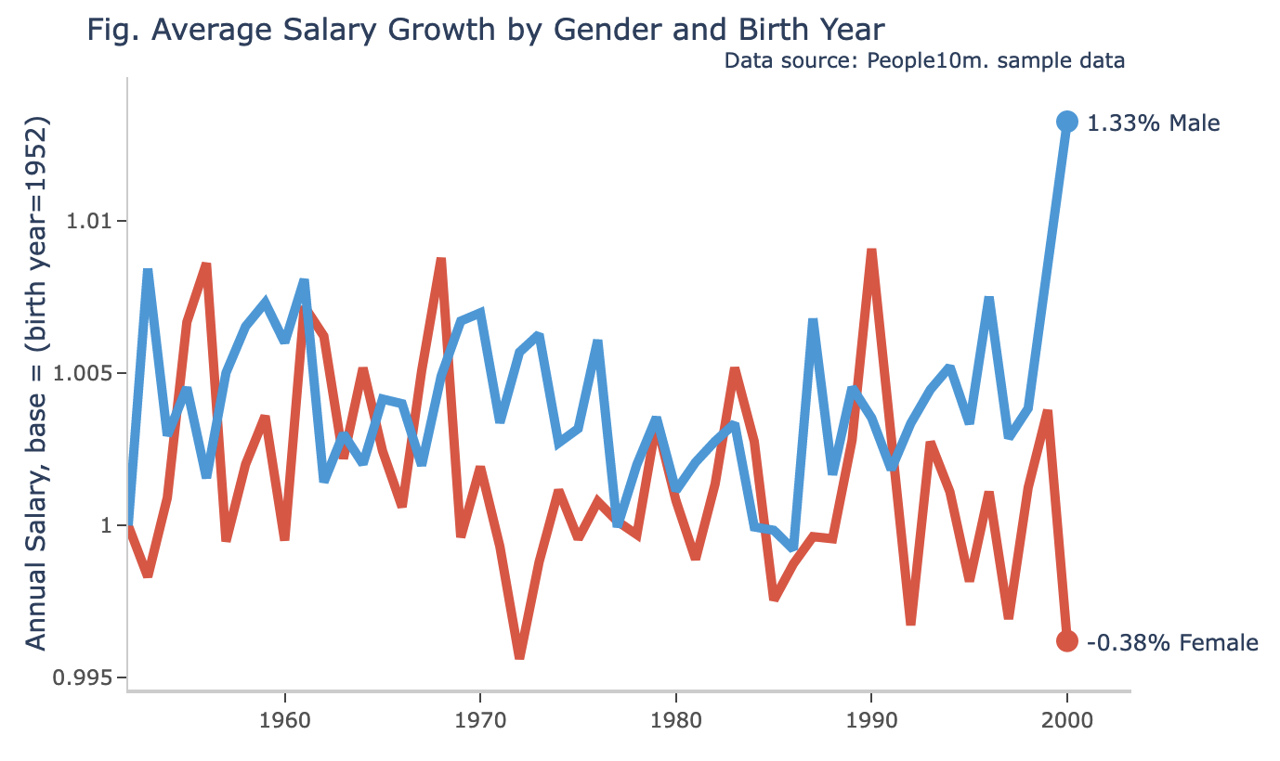
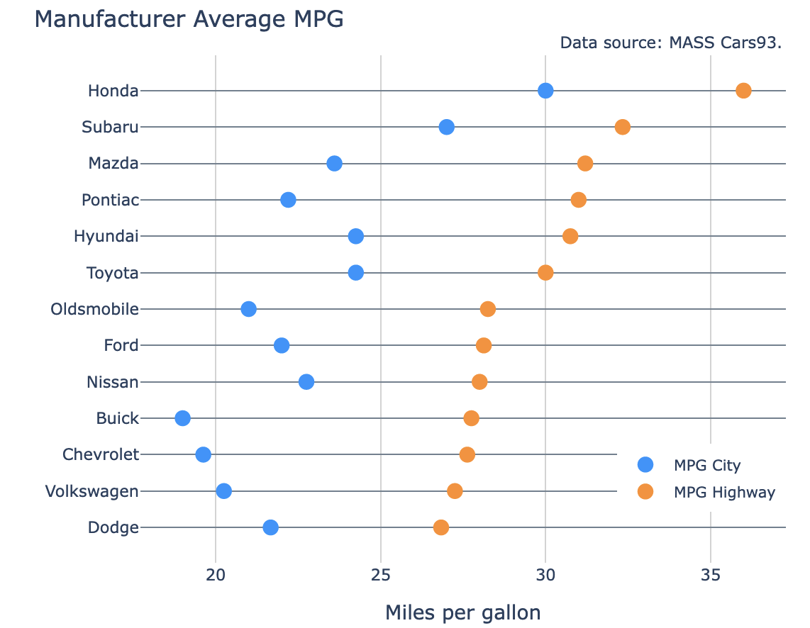
6. Python Data Science Tools
Plotly offers a variety of graph patterns and customizations

Slide 25
Appendix

Slide 26
Common Data Visualization Tools
Patterns
Comparison, composition
Bar, components, flow/sankey
Data distribution
Histogram, boxplot
Multi-variate distributions
Scatter plot, cluster, outlier
Semi-programmatic tool – Tableau
Programmatic tools – R, Python
Pros: more control for data & elements
Cons: less automation, risk of code errors
 | Transform | Plot
Tableau | Table expr. Calculated field/set | Row-column shelves, Marks, color, shape, size cards
R | dplyr, sqldf | ggplot2, plotly
Python | pandas, pandasql | matplotlib, Seaborn, plotly

Slide 27
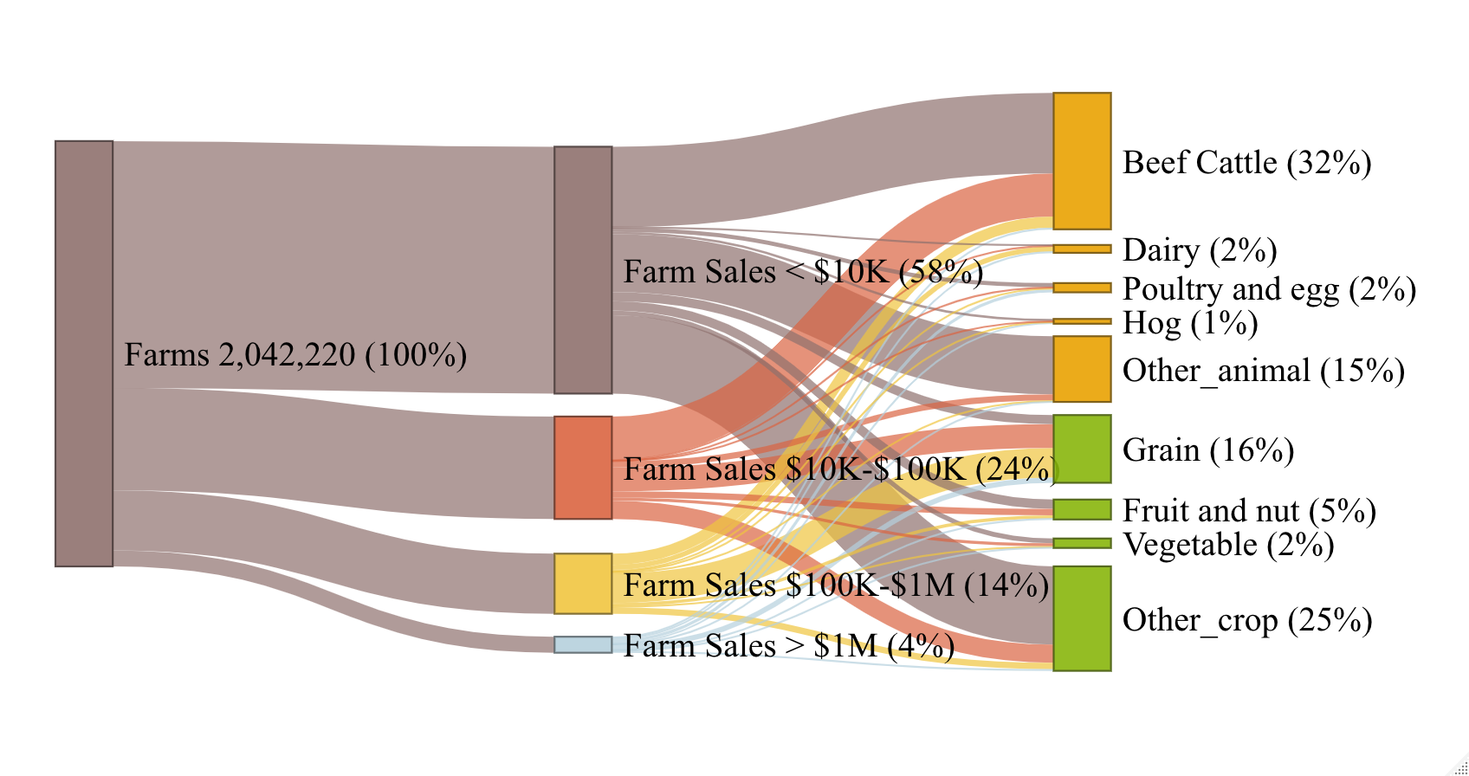
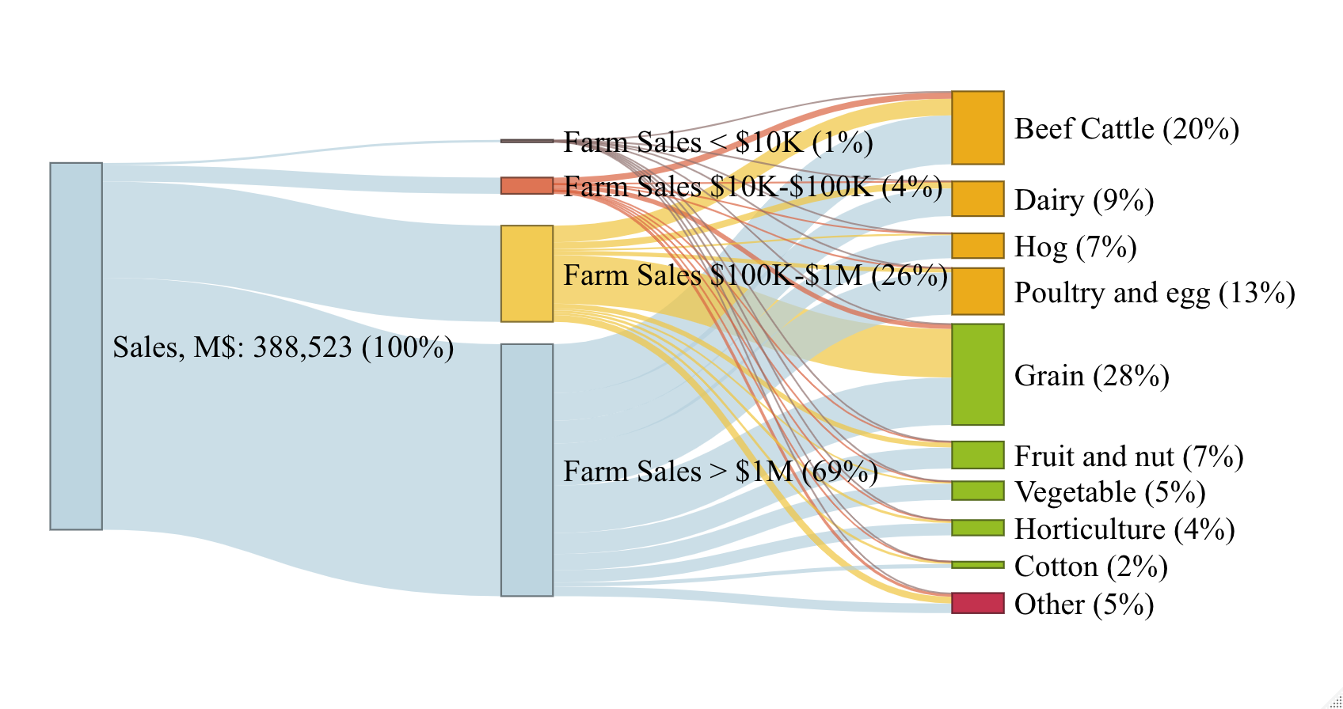
Example of Flow/Sankey Chart
Sankey charts help visualize parts of the whole
Visualizing cross tabs:
Farm sales class x Industry
Farm counts (above)
Sales value counts (below)

Slide 28
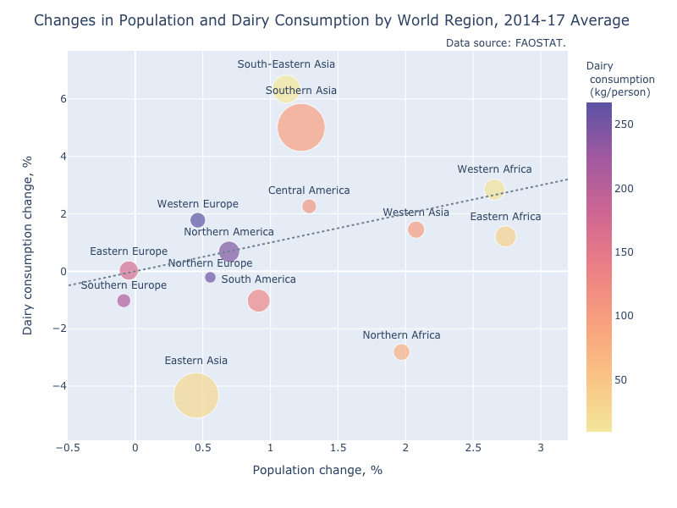
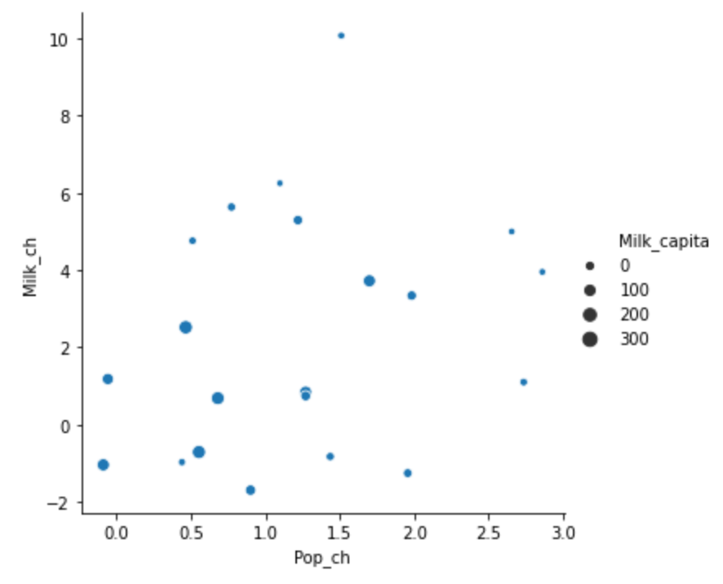
Example of Enhanced Visualization
Before
After
Note: the dotted line represents the equal rates of growth for population and dairy consumption

Slide 29
Similarities between R tools v. SQL + Tableau
R - dplyr | SQL
select (var1, var2, ...) | SELECT var1, var2, ...
filter (exp1, exp2, ... ) | WHERE exp1 AND exp2 ...
arrange ( var1, var2, ... ) | ORDER BY var1, var2, ...
mutate ( newvar1 = exp1, ...) | Case statement / Window functions
summarise (newvar1 = exp1, ...) | SUM( ), AVG( ), MIN( ), MAX( )
group_by (var1, var2, ...) | GROUP BY var1, var2, ...
Chaining operator %>%:
X %>% Y means passing left-item (X) as arg1 of right-item (Y)
This allows for sequential pipe operations.
%>% can be read as “then” in that it passes an object from left to right
df %>% filter(v1 > 0)
%>% select(v1, v2, v3, v4)
%>% mutate(ratio = v2 / v3)
%>% group_by(v4)
%>% summarise (
avg1 = mean(v1),
ratio = mean(ratio))
%>% ggplot(aes(avg1, ratio)) +
geom_point(color = v4)
R – ggplot2 | Tableau
X-Y axis: ggplot(data, aes(x=var1, y=var2)) | Row – Column shelves
geom_point( ), geom_bar( ), etc. | Marks card/chart type
facet_wrap (var1,...) | Secondary row, column
color=var1, shape=var2, size=var3 | color, shape, size cards

